Slide 1
Solar Photovoltaic Ordinance for New Residential Construction
Name, Title, Department
Date
Notes:
[This presentation template can be used at a City Council or Board of Supervisors meeting and includes suggested talking points that should be modified as needed.]
This presentation provides an overview of the Bay Area Rooftop Solar PV model ordinance adapted from the Draft Model Ordinance developed by the California Energy Commission. This ordinance would require offsetting approximately 80% of a new building’s electric consumption with solar, and upon adoption would affect new construction permitted through December 31, 2019.

Slide 2

Overview
Why Rooftop Solar Photovoltaic (PV)
Solar Ordinance
  Requirements
  Compliance Methods
  Benefits and Resources
Next Steps
Notes:
In this presentation, we will discuss the basis of the ordinance, how it fits into local energy goals, and how to help close the gap on State targets for renewable energy and GHG reductions. We will also discuss the requirements for the ordinance, including the two main pathways for adoption, and where we can go from here.

Slide 3


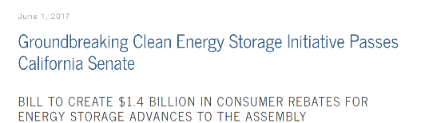

Why Rooftop Solar PV?
Solar Briefly Topped 50% of California Electricity in March, Driving Rates Below Zero
David Z. Morris
Apr 08, 2017
Notes:
It is still possible for jurisdictions to build resilience at the local level despite current political conditions and future climate uncertainty. As local and national events have demonstrated, managing our energy needs are becoming paramount to ensuring the wellbeing of our communities and continual functioning of our critical infrastructure.
Jurisdictions have the opportunity to pursue a low cost approach through this solar ordinance on new residential construction.
This will help with meeting the state’s aggressive clean energy goals, including the goal that all new residential construction be zero net energy by 2020. This is an important challenge to meet as most homebuilders and developers continue to build the majority of projects without solar—in the first quarter of 2016, fewer than ten percent of new homes in California included a solar installation.

Slide 4
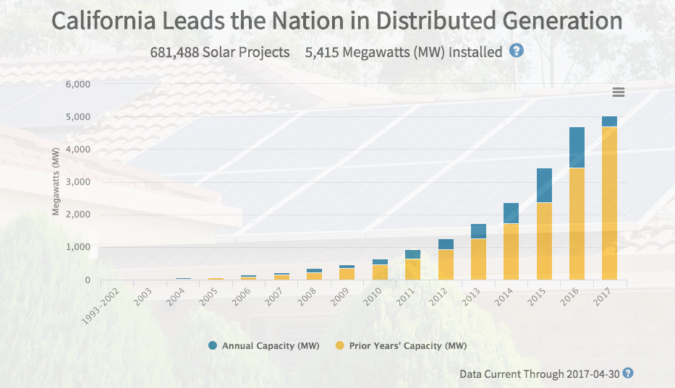
Solar is Mainstream
Notes:
Solar is a proven method of providing clean energy. Falling costs and progressive State policies make it competitive to conventional power.
Including solar PV systems in new residential construction is a cost-effective means of reducing greenhouse gas emissions. It is simple, safe, reliable and popular.
This California Distributed Generation Statistics (California DG Stats) graph currently includes data for all solar photovoltaic (PV) systems interconnected through the California Investor Owned Utilities (IOUs) net energy metering (NEM) tariffs.
Source of graphic: http://www.californiadgstats.ca.gov/faq/

Slide 5


Alignment with State & Regional Goals
GHG Reduction: 40% below 1990 levels by 2030 & 80% below 1990 levels by 2050
Zero Net Energy (ZNE) Requirements:
For all new residential by 2020; all new commercial & 50% existing commercial by 2030
Notes:
Solar PV is critical to the next phase of California’s clean energy strategy. The State has set ambitious renewable energy targets for new construction, using solar as a means of achieving zero-net-energy (ZNE) in all new residential buildings by 2020. The Zero Net Energy Building goals have also been supported in the California Energy Action Plan, the AB 32 (California Global Warming Solutions Act) Scoping Plan, the Governor’s Clean Energy Jobs Plan, and the Clean Energy Futures Vision.
This ordinance would also support regional targets put forward by the Bay Area Air Quality Management District, in the 2017 Clean Air Plan, “Spare the Air, Cool the Climate”. It also includes an aggressive goal to achieve an 80% reduction in greenhouse gas emissions below 1990 levels by 2050. This ordinance would be a step toward achieving necessary emission reductions for new residential buildings and their on-going electricity needs.

Slide 6
Alignment with Local Goals
Reference local climate action plan goals if appropriate
Notes:
Local adoption of this ordinance would also help advance our local [climate action plan/sustainability plan] goal of _______________. The installation of rooftop solar PV could yield up to [xx%] in GHG reduction in our [appropriate climate zone.]

Slide 7
Benefits of Solar PV Ordinance
Long-term decrease in operating costs
15-year simple payback for owners
First year utility bill savings of $XX per single-family unit and $YY per multifamily unit
ZZ% reduction in greenhouse gas emissions
Prepare for new zero-net energy building codes
Local Resilience
  Coupled with storage capabilities, PV can power essential systems during outages
Notes:
The cost to retrofit existing homes is far greater than the incremental cost of adding these low carbon features during new home construction. Such homes are more affordable to operate and thus more attractive to homebuyers due to the lower monthly energy bills.
It is projected that solar will achieve a 15-year simple payback for owners. First-year utility bill savings are projected to be $XXX per single-family unit and $YYY per multifamily dwelling unit. The incremental first costs are projected to be $XXX per single-family unit and $YYY per multifamily dwelling unit.
Green house gas emissions are expected to be YY% less than the standard code-compliant home.
Adoption of the proposed ordinance will capture opportunities for installations in new construction prior to 2020 that would otherwise be lost and help prepare staff and the development community for the transition to ZNE in 2020.
Also, solar electricity not only produces sustainable clean energy, but with advances in electricity storage technologies, it can power essential system during disruption of electricity from the grid.

Slide 8
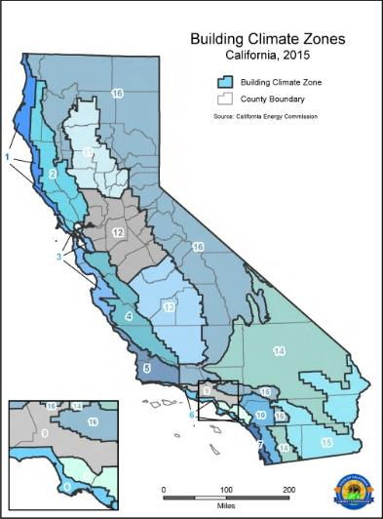
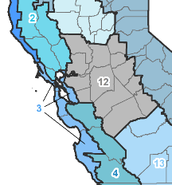
Rooftop Solar PV is Cost-Effective
Solar PV in new residential development is feasible and cost-effective in all 16 California climate zones.
15-year simple payback for users
Bay Area Climate Zones: 2, 3, 4, 12
Notes:
This cost-effectiveness study for the ordinance used statewide average values for its solar installation cost assumptions, and included the State New Solar Homes Partnership (NSHP) rebate values of $0.50/watt and the Federal Tax Credit of 30 percent of the post-rebate installed system cost. Incremental development costs for single and multifamily residential buildings were also accounted for. Using these values, the study determines that minimum solar PV installations on new residential construction would be both feasible and cost effective in every one of the sixteen climate zones in California.
Benefits to homeowners include utility bill savings during the lifetime of the system which outweigh the incremental costs of the systems. First-year saving for single-family residences are projected at about $720 annually; multi-family savings are projected at about $370 annually. A typical system will pay for itself from energy bill savings in about 15 years.

Slide 9
Bay Area Cities that have adopted Solar Ordinances
San Francisco
San Mateo
Palo Alto
Fremont
Brisbane
Sebastopol
Notes:
Several other California cities have already established ordinances for renewables.

Slide 10
Solar Ordinance Requirements
Applies to all new single-family and low-rise multifamily (3 stories or less) residential buildings
Prescriptive pathway specifies minimum solar capacity based on home size
Performance pathway offers flexibility to trade off energy efficiency and solar
Notes:
The solar ordinance requirements offset approximately 80% of a new building’s electric consumption and would affect new construction permitted through December 31, 2019.
The ordinance applies to solar PV in new construction of single-family and low-rise multifamily buildings. It offers both prescriptive and performance compliance pathways. The prescriptive method applies only to smaller buildings and simply requires the design to meet the State’s minimum efficiency standards and includes a minimum amount of PV based on the square footage of the building’s conditioned space. The performance approach provides more flexibility by allowing applicants to use a combination of energy efficiency and renewables to achieve a specified energy performance level.

Slide 11
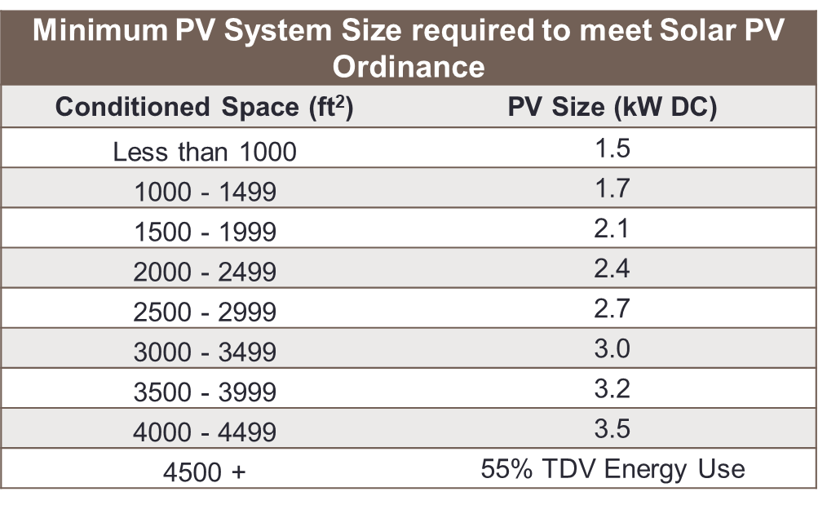
Compliance Methods
Performance Approach
The solar PV system must be designed to provide [45% for climate zones 2, 4, 12 , or 55% for climate zone 3] of a home’s total energy consumption
Prescriptive Approach [use values for local climate zone]
System size is determined by the size of the home
Example; insert appropriate table for climate zone
Notes:
Ordinance offers both prescriptive and performance pathways to achieve compliance. If pursuing Performance Approach, state:
The requirements are designed to size the solar PV system such that it will provide [45% or 55%--depending on climate zone] of a home’s overall energy needs, which amounts to about 80% of a home’s electricity demand.
Provides more flexibility by allowing applicants to use a combination of energy efficiency and renewables to achieve a specified energy performance level;
If pursuing prescriptive approach, state:
Prescriptive approach applies only to smaller buildings;
Simply requires that the design meets the State’s minimum efficiency standards and includes a minimum amount of PV based on building floor area;
*Benefit: This conservative approach provides a positive economic outcome with a minimal risk of overproduction of electricity.

Slide 12
Alternatives and Exceptions
Solar PV is the default option
Alternative compliance methods
  Other forms of renewable electric generation
  Solar plus storage
Exceptions if solar is not practical
  15% improvement in energy efficiency
  Commitment to a community solar program
  Requirements can be reduced or waived at the discretion of the building official
Notes:
[Edit slide and text to match options included in the local ordinance]
The scope of the ordinance is limited to solar PV in residential buildings. This is because local amendments to state code must be supported by an analysis that demonstrates cost-effectiveness, a finding supported by the analysis commissioned by PG&E using ratepayer funds.
The ordinance allows for alternative approaches for compliance. Applicants can install another form of renewable electric generation, such as wind, or may substitute a portion of the required solar capacity with energy storage, such as batteries.
If it is impractical to install solar because of shading or other reasons, buildings can be designed to exceed State energy efficiency standards or the building official may waive or reduce the requirements.
The ordinance also provides that if solar is impractical, the owner could commit to participation in a community solar program that would construct solar elsewhere in the community. At present, there is no such program in the community but this option could exist in the future.

Slide 13
State and Federal Resources
Financial Incentives Available
  State
  New Solar Homes Partnership provides support to new home builders and developers
  http://www.gosolarcalifornia.org
  Federal
  Federal Investment Tax Credit of up to 30% of project costs, but will phase down over next few years.
Notes:
There are both State and Federal financial incentives that are still available for installing PV systems on homes.
The State’s New Solar Homes Partnership program provides financial support to new home builders and developers for installing PV systems on new residential rooftops.
The Federal Investment Tax Credit provides up to 30% of the cost of a PV project. This program is scaling down over the next several years.

Slide 14



Regional Support
Bay Area Solar PV Ordinance Program
  Solar Ordinance Toolkit
  One-on-one technical assistance
  Bi-Monthly Work Sessions
  Connect to external resources
Notes:
The Bay Area Model Solar PV Ordinance is a partnership effort of the Bay Area Regional Collaborative, the Bay Area Air Quality Management District, and the Bay Area Regional Energy Network.
These regional agencies have designed a toolkit to provide local governments with tools and materials to facilitate amending their existing building codes to accelerate the adoption of rooftop solar electricity generation. The program also provides Bay Area jurisdictions with opportunities to convene with peers from other jurisdictions, and technical expertise on local energy code issues.

Slide 15
Community Engagement
[Optional Identify and describe any outreach, commission and/or subcommittee activity that has occurred.]

Slide 16
Next Steps
[Modify based on where jurisdiction is in the process]
Engage Stakeholders
Adoption by Council or Board
Submit application to the California Energy Commission for approval (60-90 days)
Notices to Developers and Contractors

Slide 17
Questions?
Name, Title, Department

